Slide 1
Short Course
Fuzzy Set Theory and Control

Slide 2





Fuzzy Decision Making
Purchase order?
Demand
Holding cost
Lost of sales
Savage value

Slide 3
A Simple Control Rules
If demand is strong and
inventory level is low
then purchase amount is large
Linguistic Variables to be handled
by fuzzy sets.

Slide 4
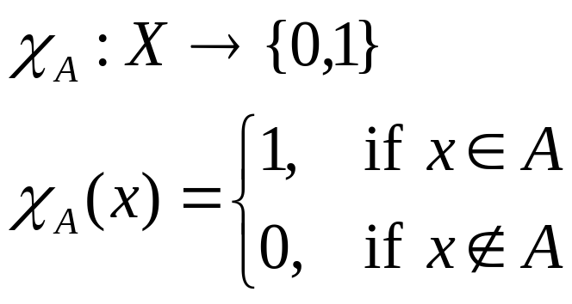
Ordinary Set Theory
X
universe
Characteristic Function

Slide 5
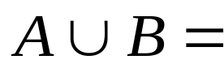

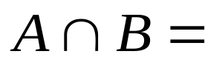
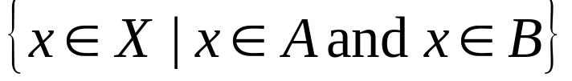

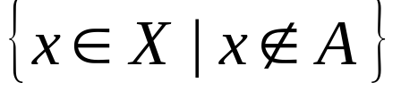

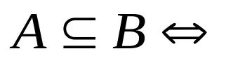
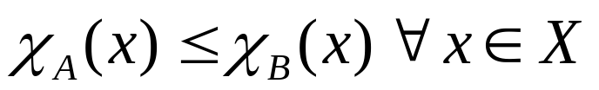
Classical Set Operations

Slide 6
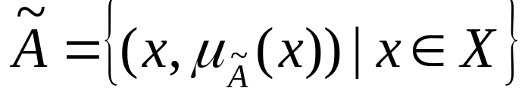
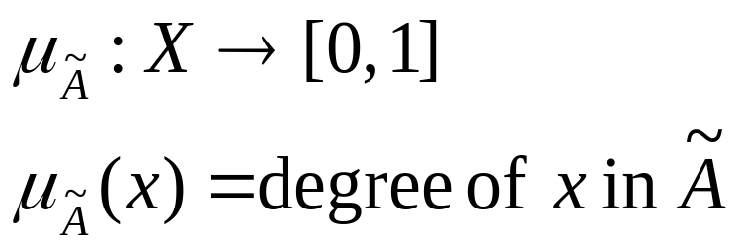
Fuzzy Set Theory
X
universe
Membership Function

Slide 7
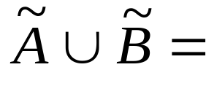
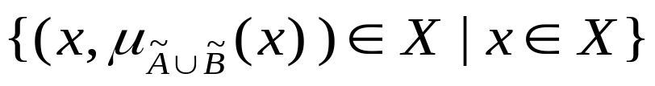
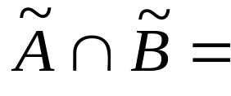


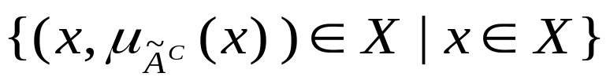
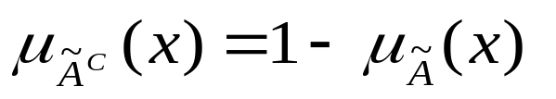
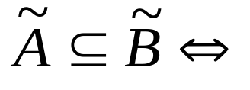
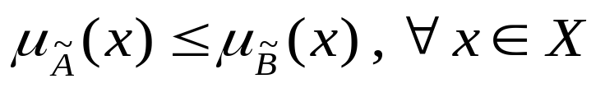
Fuzzy Set Operations

Slide 8
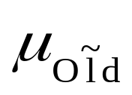
Example – Membership (I)
Old People
1
0
50
100

Slide 9
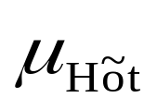
Example – Membership (II)
Hot Weather
1
0
20
40

Slide 10
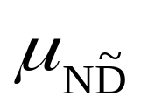
Example – Membership (III)
Normal Demand
1
0
50
75
100

Slide 11
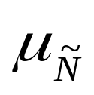
Example – Membership (IV)
N is close to 10 and much larger than 5
1
0
5
10
15

Slide 12
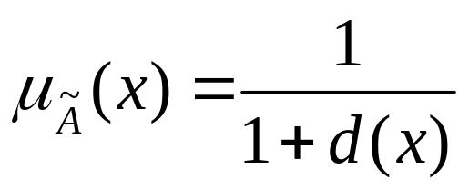
Membership Function
Distance approach (near, close to, around,…)
Statistical approach (normal, average,…)
Expertise approach (evaluation)
Utility Function approach (better, high,..)
Truth Value approach
Axiomatic approach

Slide 13
Fuzzy Number
Triangular Fuzzy Number
Trapezoidal Fuzzy Number

Slide 14
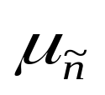
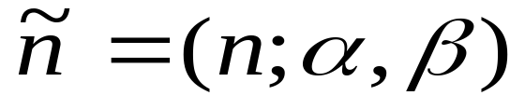
Triangular Fuzzy Number
1
α
β
0
n-α
n
n+β
right spread
left spread

Slide 15
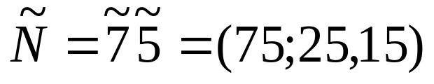
Example – Triangular Fuzzy Number
1
25
15
0
50
75
90

Slide 16
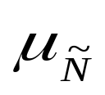
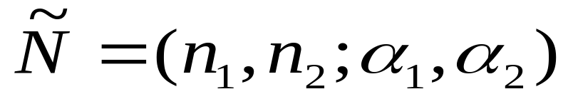
Trapezoidal Fuzzy Number
1
α₁
α₂
0
n₁-α₁
n₁
n₂
n₂+α₂

Slide 17
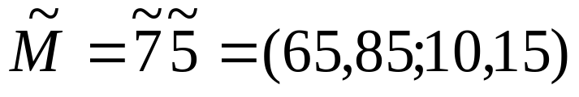
Example – Trapezoidal Fuzzy Number
1
10
15
0
55
65
85
100

Slide 18
Fuzzy Arithmetic
Fuzzy Addition
Multiplication with Scalar
Fuzzy Subtraction
Fuzzy Multiplication
Fuzzy Modifier

Slide 19




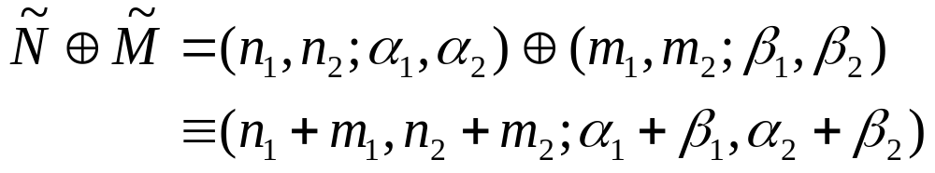
Fuzzy Addition
n₁-α₁
n₁
n₂
n₂+α₂
m₁-β₁
m₁
m₂
m₂+β₂
=
n₁+m₁-α₁-β₁
n₁+m₁
n₂+m₂
n₂+m₂+α₂+β₂

Slide 20




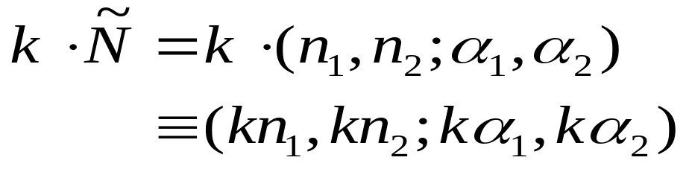
Multiplication with Scalar
n₁-α₁
n₁
n₂
n₂+α₂
=
k(n₁-α₁)
kn₁
kn₂
k(n₂+α₂)

Slide 21


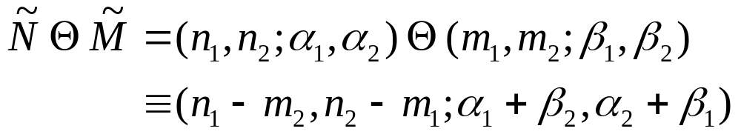
Fuzzy Subtraction
n₁-α₁
n₁
n₂
n₂+α₂
m₁-β₁
m₁
m₂
m₂+β₂
=
n₁-m₂-(α₁+β₂ )
n₁-m₂
n₂-m₁
n₂-m₁+(α₂+β₁ )

Slide 22
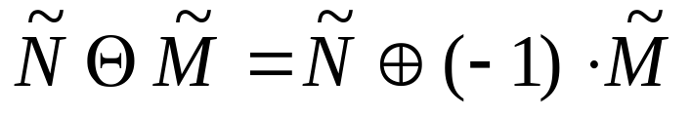
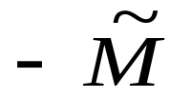
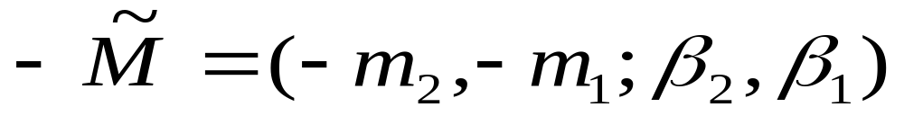
Question:
?
-m₂-β₂
-m₂
-m₁
-m₁+β₁

Slide 23


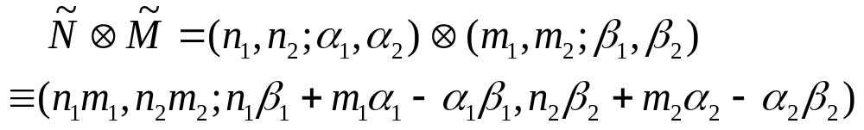
Fuzzy Multiplication
n₁-α₁
n₁
n₂
n₂+α₂
m₁-β₁
m₁
m₂
m₂+β₂
=
(n₁-α₁) ( m₁-β₁)
n₁m₁
n₂m₂
(n₂+α₂) ( m₂+β₂)

Slide 24
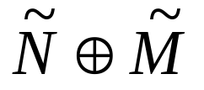
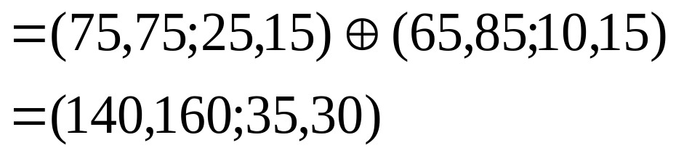
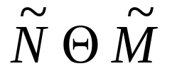
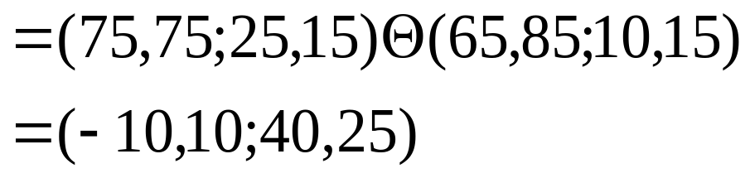
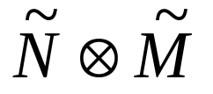
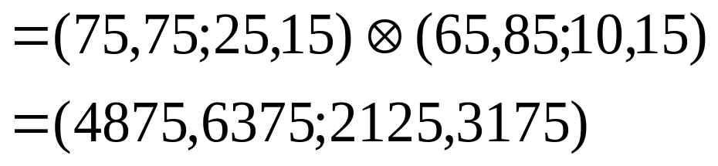
Example

Slide 25
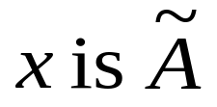
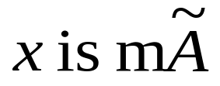
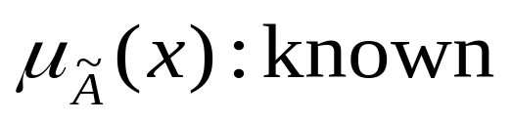
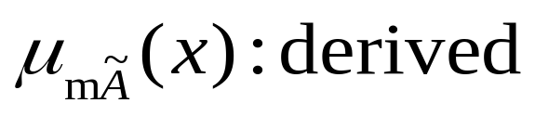
Fuzzy Modifier
x is small x is very small
very very small
more or less small
not small
not very small
Modifier or hedge

Slide 26

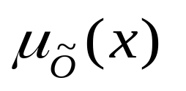
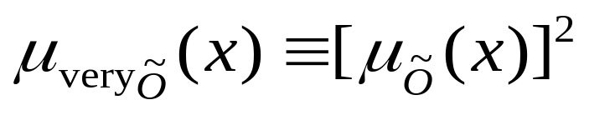
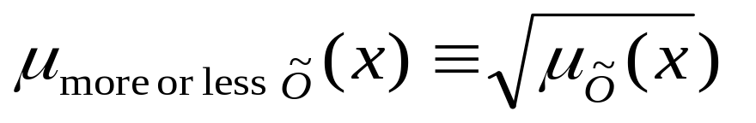
Fuzzy Quantifiers
1
0
25
50
75
100
Old
very Old
more or less Old

Slide 27
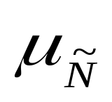
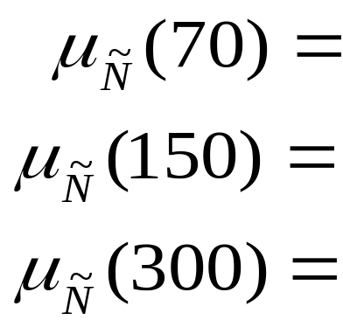
Example
x (demand) is normal
1
0
60
100
200
250
quantity
0.25
1
0

Slide 28
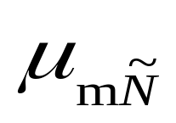

Example
x is more or less normal
1
0
60
100
200
250
quantity
0.5
1
0

Slide 29


Example
x is not normal
1
0
60
100
200
250
quantity
0.75
0
1

Slide 30


Example
x is not normal and x is more or less normal
1
0
60
100
200
250
quantity
0.5
0
0

Slide 31
Example
x is not normal or x is more or less normal
1
0
60
100
200
250
quantity
0.5
0
1

Slide 32


Fuzzy Proposition

Slide 33




Generalization
Y
X

Slide 34


Example
y (inventory) is high
1
0
500
800
quantity
0
.5
1

Slide 35


0.25
0
0
0.25
1
0
1
0
0
0
0.5
0.25
0.5
0.5
1
0
0.5
1
0.25
1
1
1
0
1

Slide 36
Relations
Relation ≡ A subset of the product of two sets,
R : X × Y. If (a, b) is an element of
R then we write aRb, meaning a is
related to b by R.

Slide 37



Crisp Relations
Relation
R ( = ): Y is twice as big as X:
2
Y
2
2
X

Slide 38


Relations
Fuzzy Relation
R ( = ): Y is about twice as big as X:
~
~
2
Y
~
~
2
~
~
X
2

Slide 39


Fuzzy Relation

Slide 40
Example - Fuzzy Relation
inventory | Customer satisfaction level
 | 50% | 60% | 70% | 80% | 90% | 100%
1-week | 0.8 | 0.7 | 0.3 | 0.2 | 0.1 | 0.0
2-week | 0.1 | 0.3 | 0.9 | 0.3 | 0.2 | 0.1
3-week | 0.0 | 0.1 | 0.2 | 0.9 | 0.5 | 0.3
4-week | 0.0 | 0.0 | 0.0 | 0.2 | 0.9 | 1.0

Slide 41

0.1
0.3
0.9
0.3
0.2
0.1
Interpretation:
Holding 2-week inventory is highly related to satisfy “about 70%” customers.

Slide 42






Composition of Fuzzy Relations
X
Y
Z

Slide 43








Example

Slide 44















Solution
0.1
0.7
0.1
0.2
0.4
0.2
= 0.3
0.3
0.6
0.3
0.2
0.6
0.2

Slide 45




Special Case
X
Y

Slide 46

Fuzzy Application
Inventory is normal
1.0
0.7
0.2
0.1
1
2
3
4
weeks

Slide 47
inventory | Customer satisfaction level
 | 50% | 60% | 70% | 80% | 90% | 100%
1-week | 0.8 | 0.7 | 0.3 | 0.2 | 0.1 | 0.0
2-week | 0.1 | 0.3 | 0.9 | 0.3 | 0.2 | 0.1
3-week | 0.0 | 0.1 | 0.2 | 0.9 | 0.5 | 0.3
4-week | 0.0 | 0.0 | 0.0 | 0.2 | 0.9 | 1.0
Question: When inventory is normal, what is
the customer satisfaction level?

Slide 48
inventory | Customer satisfaction level
 | 50% | 60% | 70% | 80% | 90% | 100%
1-week | 0.8 | 0.7 | 0.3 | 0.2 | 0.1 | 0.0
2-week | 0.1 | 0.3 | 0.9 | 0.3 | 0.2 | 0.1
3-week | 0.0 | 0.1 | 0.2 | 0.9 | 0.5 | 0.3
4-week | 0.0 | 0.0 | 0.0 | 0.2 | 0.9 | 1.0
0.1
1.0
0.2
0.0
0.1
0.3
0.9
0.3
0.2
0.2

Slide 49

When inventory is normal, the customer satisfaction level is
1.0
0.7
0.3
0.1
50
60
70
80
90
100
%

Slide 50
Question: When inventory is very normal, what
is the customer satisfaction level?
inventory | Customer satisfaction level
 | 50% | 60% | 70% | 80% | 90% | 100%
1-week | 0.8 | 0.7 | 0.3 | 0.2 | 0.1 | 0.0
2-week | 0.1 | 0.3 | 0.9 | 0.3 | 0.2 | 0.1
3-week | 0.0 | 0.1 | 0.2 | 0.9 | 0.5 | 0.3
4-week | 0.0 | 0.0 | 0.0 | 0.2 | 0.9 | 1.0
0.01
1.00
0.04
0.00
0.1
0.3
0.9
0.3
0.2
0.1

Slide 51
When inventory is very normal, the customer satisfaction level is
1.0
0.7
0.3
0.1
50
60
70
80
90
100
%

Slide 52


Logic
Logic Statement : If A then B. (A → B)
Truth Value Table
B
B
A
A
(A → B) is a relation R(A, B) between A and B,
which is equivalent to the statement (not A or B).

Slide 53

Crisp Implication
If your body temperature is “normal”,
(i.e., 98 or 99 degrees)
then your condition is “good”.
(i.e., 9 or 10 on a 10-point scale)
X = {97, 98, 99, 100} temperature
Y= {8, 9, 10} condition
A = {98, 99} normal
B = {9, 10} good

Slide 54





Fuzzy Implication
Fuzzy Logic Statement :
Y
X

Slide 55


Various Implication Formulas

Slide 56

b | 0 | 0.5 | 1
a
0 | 1 | 1 | 1
0.5 | 0.5 | 1 | 1
1 | 0 | 0.5 | 1

Slide 57

b | 0 | 0.5 | 1
a
0
0.5
1
1 | 1 | 1
0 | 1 | 1
0 | 0 | 1

Slide 58

b | 0 | 0.5 | 1
a
0
0.5
1
1 | 1 | 1
0.5 | 0.5 | 0.5
0 | 0.5 | 1

Slide 59

b | 0 | 0.5 | 1
a
0
0.5
1
1 | 1 | 1
0 | 1 | 1
0 | 0.5 | 1

Slide 60

b | 0 | 0.5 | 1
a
0
0.5
1
1 | 1 | 1
0.5 | 0.5 | 1
0 | 0.5 | 1

Slide 61

b | 0 | 0.5 | 1
a
0
0.5
1
1 | 1 | 1
0 | 1 | 1
0 | 0.5 | 1

Slide 62

b | 0 | 0.5 | 1
a
0
0.5
1
0 | 0 | 0
0 | 0.5 | 0.5
0 | 0.5 | 1

Slide 63





Example
If your physical temperature is “normal”, then your body condition is “good”.
normal
good
1
1
0.5
0.5
97
98
99
8
9
10

Slide 64


0.2
0.6
1.0
 | Y | 8 |  | 9 | 10
X
97
98
99
0.5
1.0
0.7

Slide 65


0.2
0.6
1.0
 | Y | 8 |  | 9 | 10
X
97
98
99
0.5
1.0
0.7

Slide 66
Fuzzy Reasoning
Case I
If a person’s body temperature is “normal” then the person is in “good” health
+ Jerry’s body temperature is “very normal”.
So Jerry is in “very good” health

Slide 67



Slide 68









Example

Slide 69
Case II
If demand is “strong” and inventory is “low” then purchase amount is “high”
+ demand is “very strong” and inventory is “more or less low”
So purchase amount is “sort of high”

Slide 70



Slide 71



Example
If body temperature is “normal” and
coughing frequency is “rare”
then the chance of having T.B. is “low”

Slide 72





Given that
What is

Slide 73


By Mamdani’s Inference Rule

Slide 74


For z = ( < 10% )
x = 97, y = (1-10)
x = 98, y = (1-10)
x = 97, y = (10-20)
x = 98, y = (10-20)
0.1 0.8 0.5 1 1
∧ ∧ ∧ ∧
0.1
1 0.8 1 1 1
∧ ∧ ∧ ∧
0.8
0.1 0.3 0.5 0.1 1
∧ ∧ ∧ ∧
0.1
1 0.3 1 0.1 1
∧ ∧ ∧ ∧
0.1
0.8

Slide 75


For z = ( 10% - 20%)
x = 97, y = (1-10)
x = 98, y = (1-10)
x = 97, y = (10-20)
x = 98, y = (10-20)
0.1 0.8 0.5 1 0.2
0.1
1 0.8 1 1 0.2
0.2
0.1 0.3 0.5 0.1 0.2
0.1
1 0.3 1 0.1 0.2
0.1
0.2
0

Slide 76

How low is low for having T.B.?

Slide 77
Continuous Membership Function
Inference Rule:
If inventory is “normal” and demand is “strong” then purchase is “medium”
+ Inventory is “sort of normal” and demand is “sort of strong”
Conclusion: purchase is “sort of medium”

Slide 78






inventory
demand
purchase
1
1
1
0
100
125
150
175
0
250
300
0
100
150
200
250
1
1
1
?
0
50
112.5
150
0
240
290
310
0
100
150
200
250

Slide 79

What is the computational difficulty
Complicated Computation

Slide 80



Mamdani’s Special Case
If x is and y is then z is
x is m and y is m
(x = x₀ and y = y₀ )
z is m

Slide 81
inventory
demand
purchase
1
1
1
0
100
125
150
175
0
250
300
0
100
150
200
250
1
1
+
0
112.5
0
290
1
?
0
100
150
200
250

Slide 82




Slide 83

inventory
demand
purchase
1
1
1
0.8
0.5
0
100
125
150
175
0
250
300
0
100
150
200
250
112.5
290
0.5
0
100
125
225
250
purchase

Slide 84
Defuzzification
Now We have
0.5
0
100
125
225
250
purchase
What exact amount should be purchased?

Slide 85

Defuzzification
Max-Min ≡ minimum value of maximum degree
Max-Max ≡ maximum value of maximum degree
Max-Med ≡ median value of maximum degree
Centroid rule
Others

Slide 86

max-min
max-med
max-max
0.5
0
100
125
175
225
250
purchase

Slide 87







Review Of Fuzzy Reason
Premise 1 If x is and y is then z is
Premise 2 If x is and y is then z is
Premise 3 x is and y is
Conclusion z is

Slide 88




Fuzzy Control
A set of fuzzy inference rules
If x is and y is then z is
or if x is and y is then z is
or if x is and y is then z is
or if x is and y is then z is
Input x = x₀ and y = y₀ , what is z = ?

Slide 89








x₀
y₀
x₀
y₀
x₀
y₀
x₀
y₀

Slide 90
x₀
y₀
x₀
y₀
x₀
y₀
x₀
y₀

Slide 91


Slide 92
Defuzzification ⇒ z

Slide 93
Example --Fuzzy (Q,R) Model
Control Rules
DEMAND
LOWDEM MEDDEM HIGHDEM
LOWINV LOWPUR MEDPUR HIGHPUR
MEDINV LOWPUR MEDPUR HIGHPUR
HIGHINV LOWPUR LOWPUR MEDPUR
INVENTORY LEVEL
PURCHASE

Slide 94
Fuzzy Rules
If demand is low and inventory level is low
then purchase amount is low.
If demand is med and inventory level is low
then purchase amount is med.
If demand is high and inventory level is low
then purchase amount is high.
If demand is low and inventory level is med
then purchase amount is low.
If demand is med and inventory level is med
then purchase amount is med.

Slide 95
Fuzzy Rules
If demand is high and inventory level is med
then purchase amount is high.
If demand is low and inventory level is high
then purchase amount is low.
If demand is med and inventory level is high
then purchase amount is low.
If demand is high and inventory level is high
then purchase amount is med.

Slide 96

Membership Functions
Demand
Inventory
Purchase
5
10
15
2.5
5
7.5
45
55
65
LOW_DEMAND
LOW_INVENTORY
LOW_PURCHASE
5
10
15
2.5
5
7.5
45
55
65
MED_DEMAND
MED_INVENTORY
MED_PURCHASE
5
10
15
2.5
5
7.5
45
55
65
HIGH_DEMAND
HIGH_INVENTORY
HIGH_PURCHASE

Slide 97
Case I: Demand = 7, Inventory = 4
Demand
Inventory
Purchase
5
10
15
2.5
5
7.5
45
55
65
5
10
15
2.5
5
7.5
45
55
65
5
10
15
2.5
5
7.5
45
55
65

Slide 98
Demand
Inventory
Purchase
5
10
15
2.5
5
7.5
45
55
65
5
10
15
2.5
5
7.5
45
55
65
5
10
15
2.5
5
7.5
45
55
65

Slide 99
Demand
Inventory
Purchase
5
10
15
2.5
5
7.5
45
55
65
5
10
15
2.5
5
7.5
45
55
65
5
10
15
2.5
5
7.5
45
55
65

Slide 100
45
55
65
45
55
65
45
55
65
45
55
65
max-med
max-max
⇒
max-min
centroid
45
55
65

Slide 101
Case II: Demand = 10, Inventory = 5
Demand
Inventory
Purchase
5
10
15
2.5
5
7.5
45
55
65
5
10
15
2.5
5
7.5
45
55
65
5
10
15
2.5
5
7.5
45
55
65

Slide 102
Demand
Inventory
Purchase
5
10
15
2.5
5
7.5
45
55
65
5
10
15
2.5
5
7.5
45
55
65
5
10
15
2.5
5
7.5
45
55
65

Slide 103
Demand
Inventory
Purchase
5
10
15
2.5
5
7.5
45
55
65
5
10
15
2.5
5
7.5
45
55
65
5
10
15
2.5
5
7.5
45
55
65

Slide 104

max-max
max-med
max-min
⇒
centroid
45
55
65

